Slide 1
RUNNERS’ BRIEFING
PLEASE SIT IN A ROW WITH YOUR COLLEGE AND DIVISION
& HAVE A SIGNED INDEMNITY FORM READY

Slide 2
WHO SHOULD BE HERE?
ALL competitors must attend this briefing (unless we have agreed alternative arrangements)
Sit with your college and get your signed indemnity ready including the medical form
You must :
Attend the whole session
Have your name checked off
Hand in your Indemnity Form

Slide 3
ACKNOWLEDGEMENTS
Traditional and existing landholders
Bupa
ANU Sport
Q-city Transit, WICEN Radio, EPIRBHire, YellowBrick Tracking, ANU Carshare,
ANUSA and the Student Extra-curricular Enrichment Fund (SEEF)
All agencies, stakeholders and supporting organisations
The ANU, its Residences, staff, coaches, colleges coordinators
Runners
Notes:
We acknowledge and celebrate the First Australians on whose traditional lands we meet, and pay our respects to the elders of the Ngunnawal people past and present
Unrivalled access to some of the most beautiful parts of Australia
Coaches

Slide 4
A MESSAGE FROM BATYR

Slide 5
A MESSAGE FROM BUPA

Slide 6
ACT ELECTION
It’s this saturday
If you’re enrolled in the ACT, you’ll need to vote early

Slide 7
RULES
Inward Bound can be a DANGEROUS event. Rules are here for your safety.
Please read the Rules on the Inward Bound website before the event
Penalties include time penalties, disqualification of your team, disqualification of your entire college & suspension from future participation in the event.
Notes:
Stress safety.

Slide 8
THE RACE

Slide 9
Scrutineering
AT BRUCE HALL
- Check the website for time schedule
Have ready to hand over:
- mobile phone per team
- student ID/ other ID per runner
Notes:
WHAT IS IT ?
Don’t pack carefully – you’ll have to chuck it all out.
Full Scrut, everything will be checked
DON’T BE LATE

Slide 10
COMPULSORY EQUIPMENT at SCRUT
ALL COMPULSORY ITEMS WILL BE CHECKED
Check the website for equipment list
Scrutineering isn’t a joke.
Reminder: No interaction with spectators after you have entered scrutineering
Notes:
If you still need compulsory equipment - MONT
All clothing must FIT (no “child thermals”)
Food must be appropriate for at least 48 hours (NOT 1kg of lollies or a dry loaf of bread)
REMEBER - WATERPROOF JACKETS AND HATS!!!! AND SUNSCREEN PER TEAM

Slide 11
COMPULSORY EQUIPMENT at SCRUT
You will receive:
Runner’s bib (worn on front at ALL times)
GPS / Satellite Tracker
Blindfolds (x2 each)
Basic First Aid Kit
YOU must supply all other mandatory items.

Slide 12
BUSES
Once on the bus, do not remove your blindfold unless instructed to do so
Cheating = disqualification
Notes:
Compasses on lap,
Chaperones take note and you will be disqualified

Slide 13
BUSES
ONE toilet break (GO DURING SCRUTINEERING)
Layer up – could be sitting roadside for 2hrs!
Bus trips will be long for some divs this year
Notes:
Compasses, split runners from different colleges

Slide 15
WHAT’S HAPPENING?
The old course area rule does not apply
You’ll get the maps you need at the drop
Don’t need to any bring maps
All maps needed to complete the race will be given at the drop.
You can bring your own maps and the old rules of having lead drivers pick up maps will apply (only if left by the end of the scouting period - otherwise it’s your responsibility to pick them up).

Slide 16
AT THE DROP
Your Lead Driver will supply:
An A3 Zippy Bag (The Race Pack) containing:
2 x 1:50’000 Course maps
Includes exclusion zones and Whitelist zones, waterdrops and Hwy Crossing
The Course Information Sheet
Includes Whitelist GRs, Waterdrop GRs, Highway Crossing GR, Cutoff location and Time.
The Emergency Envelope
DO NOT OPEN THE ENVELOPE
Notes:
DO NOT REMOVE YOUR BLINDFOLD
DO NOT OPEN THE ENVELOPE
Compasses, split runners from different colleges

Slide 17
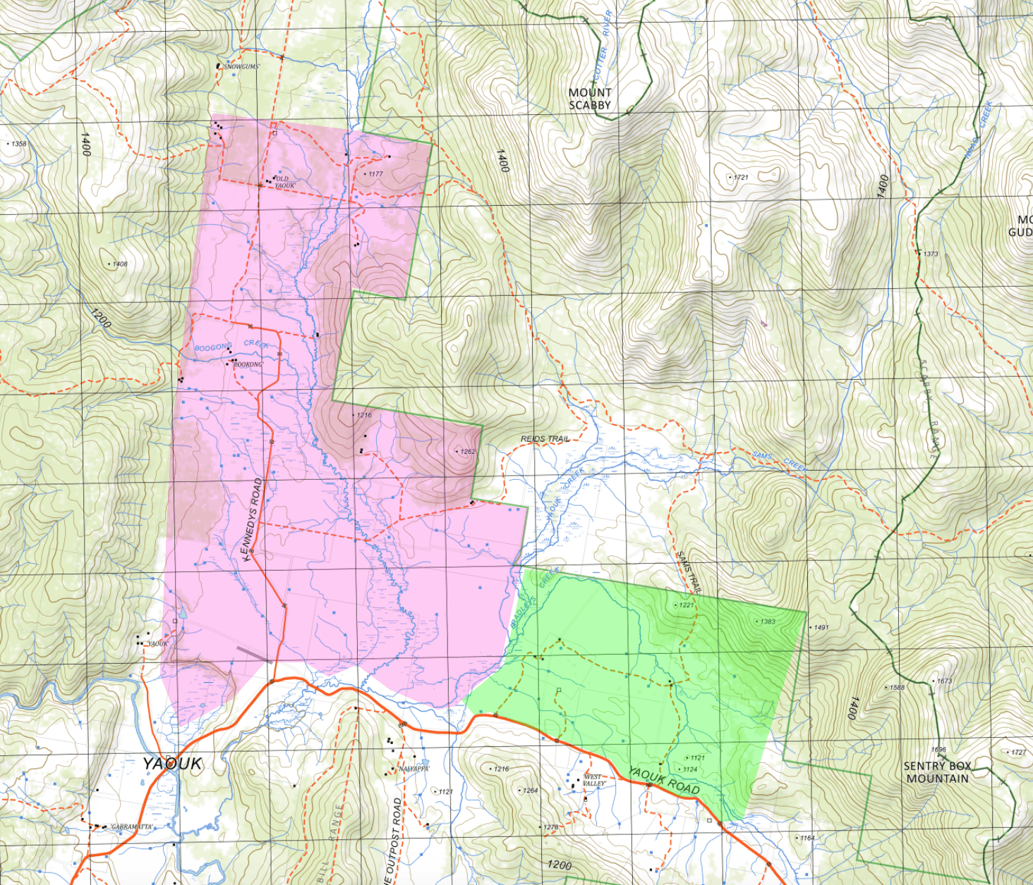
YAOUK VALLEY
The maps are the same style as the ones you’ve been training with
What’s the Green Box?!
Notes:
DEMO ENVELOPE & OOB MAP
STRESS - maximum penalty is disqualification of squad for subsequent years

Slide 18
First thing to do
READ THE INFORMATION SHEET
AND THE INFO BOX ON THE MAPS
Notes:
Compasses, split runners from different colleges

Slide 19
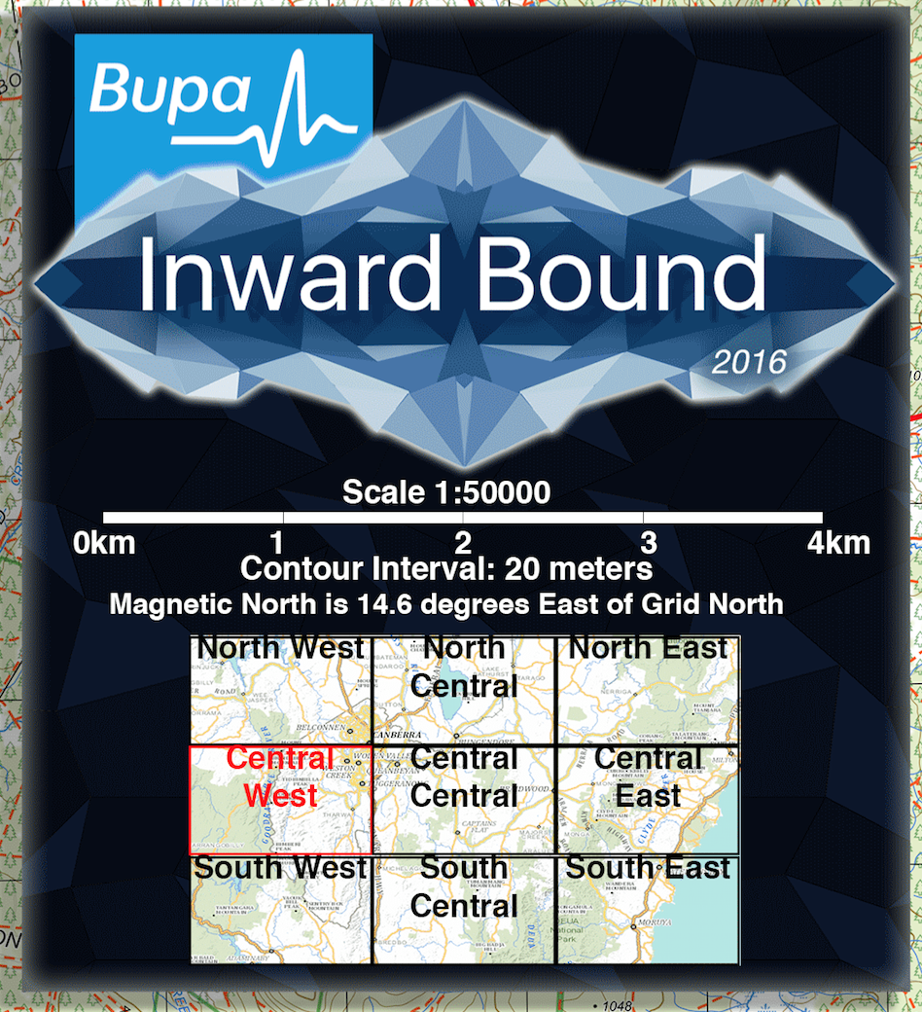
MAP INFO BOX
The Info Box shows where the two maps should be placed in relation to one another.
There will also be other text
<This Is just an example from the maps you’ve been using

Slide 20
During the race
SOME AREAS ARE OUT OF BOUNDS
Entering Out of Bounds = disqualification of your team.
Notes:
THIS DOESN’T APPLY IN EMERGENCY SITUATIONS
STRESS - maximum penalty is disqualification of squad for subsequent years
RM: (Possibly?) add that the GPS tracker this year is more accurate than in previous years - we will know if you went out of bounds

Slide 21
During the race
Out of Bounds includes:
Areas & Roads Purple Shaded on your maps
ALL HIGHWAYS
unless crossed at a checkpoint
No tunnels
ALL PRIVATE PROPERTY
unless whitelisted on course info sheet, GRs given this year
And shaded neon green on your maps
Notes:
DEMO ENVELOPE & OOB MAP
STRESS - maximum penalty is disqualification of squad for subsequent years
Private roads which we have permission for runners to cross will go on the course information sheet (ie. doctors flat road)

Slide 22
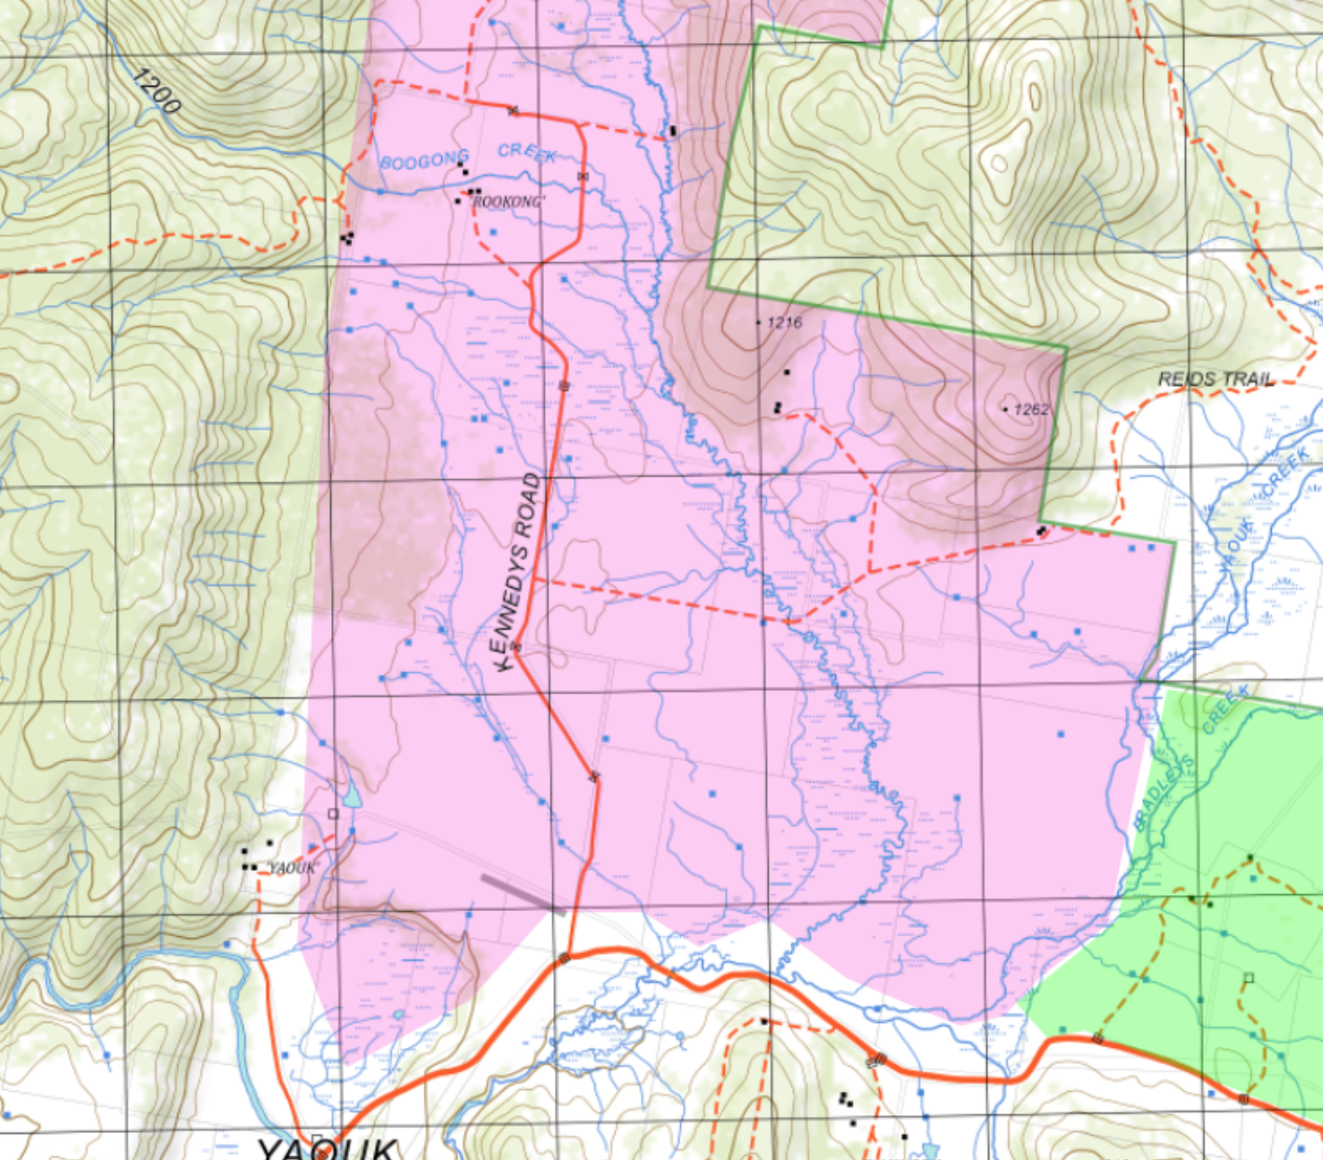
YAOUK VALLEY
CAN YOU USE THIS TRACK?
Notes:
DEMO ENVELOPE & OOB MAP
STRESS - maximum penalty is disqualification of squad for subsequent years

Slide 23
YAOUK VALLEY
CAN YOU USE THIS TRACK?
Notes:
DEMO ENVELOPE & OOB MAP
STRESS - maximum penalty is disqualification of squad for subsequent years

Slide 24
YAOUK VALLEY
CAN YOU USE THIS TRACK?
Notes:
DEMO ENVELOPE & OOB MAP
STRESS - maximum penalty is disqualification of squad for subsequent years

Slide 25
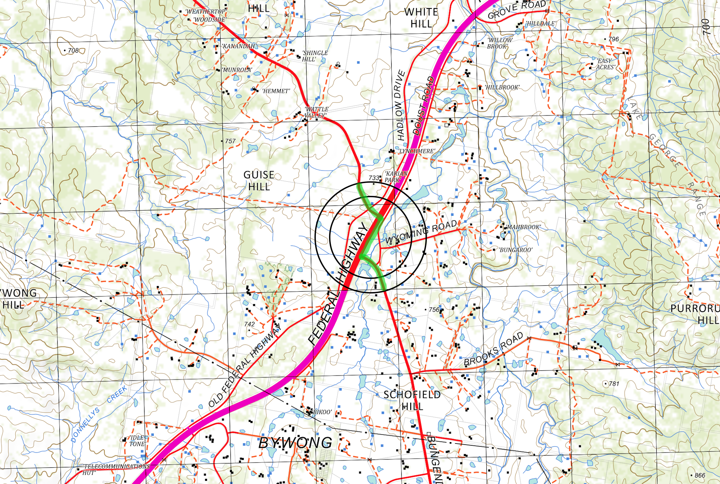

Slide 26
HIGHWAY CROSSING NOTES
When you arrive at the crossing, STOP
Let them write your College name and Div number down, then follow all instructions.
Once you have left the highway, you cannot return, if you return, you could be disqualified.

Slide 27
RACE CUTOFF at 7PM
The location for the cutoff will be printed on the Course Information Sheet.
If you have not passed, or do not think you will make it to this point by 7pm, you:
MUST CONTACT RACE HQ
by 6pm Check the Satellite Tracker for instructions from Race HQ. If no message, use SMS (if available)
Notes:
If no message, we will send emergency services looking for you

Slide 28
SCOUTING PERIOD
Div 1 – 3 40 minutes of scouting
Div 4 – 7 20 minutes of scouting
This is the only time your team members may be more than 50m apart
It starts when the drop facilitator says “Your scouting time starts now”
Notes:
Compasses, split runners from different colleges
Make sure you are back within scouting period - penalties apply
TAKE YOUR TIME --

Slide 29
DURING THE RACE
Assistance Despite the included water drops, Inward Bound is still an UNASSISTED RACE.
Plan your route with access to water in mind. Carry extra.
You cannot Ask rescue drivers on the course for directions.
IB vehicles only carry food/water for withdrawing teams.
Notes:
A team commits an offence if:
(a) the team seeks or willingly obtains information, direction, or equipment
including food from another person, and
(b) the other person is not:
(i) an official, or
(ii) a competitor.

Slide 30
DURING THE RACE
Running on Roads - ALWAYS GIVE WAY TO TRAFFIC
- Run in single file, facing oncoming traffic
- Run as far off the road as possible
- When a car approaches, stop running and move well off the road
- Do not cross a road at a bend – make sure you can see both ways
Notes:
STRESS THIS SLIDE!!!!!!!!

Slide 31
DURING THE RACE
Follow Instructions of Course Signs
(they will have the Bupa IB Logo)

Slide 32
DURING THE RACE
Public law remains
Be aware of temperamental landholders
Do not:
go through mailboxes
damage property
Shine headtorches at houses
carry illegal items (knives)
litter/dump (leave no trace)
Notes:
PRIVATE LAND IS PRIVATE
If you are in need of desperate help, approach property from driveway and respectfully ask for assistance
Do not carry alcohol

Slide 33
DURING THE RACE
Gates
Close all gates behind you, unless another team has their hand on the gate you can shut it on them.
That way no gates will be left open, no cattle will escape.
Notes:
PRIVATE LAND IS PRIVATE
If you are in need of desperate help, approach property from driveway and respectfully ask for assistance
Do not carry alcohol

Slide 34
ARRIVING AT ENDPOINT
Do not exchange ANYTHING with spectators
Head DIRECTLY to the Finishing Line:
enter through the approach (fenced corridor)
Follow all signs with the logo printed on them
your bag will be checked again for compulsory items
Notes:
all four team members must cross the finish line
If you arrive at EP before daybreak, head directly to Race HQ
no assistance
Injured runners (First Aid), St Johns will be at EP

Slide 35
AFTER YOU FINISH
Hang out at EP!
The buses will be departing EP starting at 1pm and at regular intervals from there. The timetable is on the website
All cars driven to EP need to leave by 6pm so if you finish after this time you’ll need to take a bus.

Slide 36
RACE SAFETY
Inward Bound 2015

Slide 37
RACE FIRST AID
At least one person per team should know First Aid.
The Inward Bound First Aid kit is not for general use; It is for EMERGENCY ONLY. You must carry your own First Aid supplies.
This includes strapping, band-aids, etc
There is a first aid booklet inside the First Aid Kit for advice, but it is no substitute for a course.
General First Aid advice on the Inward Bound website: http://anuinwardbound.com/first-aid/
Notes:
Stress safety.
BYO strapping tape & a box of bandaids
Up to you whether you strap before scrut or after drop
Strapping is usually preventative, but strapping after an injury can prevent it getting worse (will be uncomfortable though)
If you have no tape, a heavy crepe bandage can also immobilise a joint (i.e. sprain), but it is not recommended you continue running
St John Ambulance ACT has courses this Thursday and Friday from 0830-1730. Call on 6282 2399 or ask me & we can squeeze you in. There is no substitute for training. ANUSA may offer a subsidy on your first aid course (I got reimbursed for $100 of my first first aid course by ANUSA).

Slide 38
Medical needs
At least one person per team should know First Aid.
If you have medical conditions you must notify the Safety Officer, and
Carry your own supplies (inhaler, BSL meter, insulin, etc)
ALL runners must sign the Medical Disclosure Form
Notes:
If you are injured, immunocompromised or showing any signs of illness, we strongly advise you do not run.

Slide 39
INSURANCE COVERAGE
Inward Bound has its own Public Liability Insurance.
THIS IS NOT PERSONAL ACCIDENT INSURANCE, not for you and not for us.
All participants MUST have Australian ambulance cover and we strongly recommend your own personal accident insurance.
Notes:
Last time I checked, a metropolitan ambulance cost about $680 for a non-critical callout, and a rescue helicopter cost about $10,700. Your ambulance cover will cover the helicopter if it is needed. Bupa is offering Australian Ambulance cover from $37.30 per annum which is fully refundable if you cancel your cover without making a claim within the first 30 days.

Slide 40
General First aid and safety
Quick-reference guide on IB Website http://anuinwardbound.com/first-aid/
Emergency First Aid kit includes First Aid booklet
Look out for your mates!
Small things can become big if not addressed
Exposure is a key concern
Drink before you’re thirsty - dehydration is the biggest killjoy
Notes:
Advice on website and in first aid kit not a substitute for a course. Website advice is good, but the links to companies are out of date. Google is your friend. St John Ambulance (Deakin) will have courses this Thursday & Friday if you want to attend one.
If your teammate is limping, bleeding, etc they may not have noticed / don’t want to burden the team
Limping, pain & injury is par for the course on a race like this. But don’t keep it to yourself for shame. Be comfortable saying how you feel, or directly asking your team how they’re doing. Be comfortable saying “it hurts but I can keep going”. Fatigue and tired muscles can turn into torn muscles and stress fractures if you push yourself too hard and don’t vary your pace to allow for rest. Weigh up your options and make a team decision.
Hypo- and hyperthermia are risks overnight when it is cold and once the sun has come out. Minimise the amount of time you spend wet; minimise waterways; prefer shade over direct sun. Drink plenty of water. When you feel thirsty or headachey, yes you’re dehydrated but don’t drink start sculling water or that’ll give you trouble too. Pace yourself and sip for the whole race.
The 2L that is on the ‘minimum gear checklist’ is just that - it’s a minimum, not a recommendation. Div 7 might not drink as much water as Div 1, so be sure to pack a sufficient amount of water. Do not rely on the water drops. They may not be evenly dispersed across the course and there may not be one along your optimal route.

Slide 41
In the event of injury
Stay calm
Stick by your first-aid training
It is up to you whether or not you continue.
If an injury is serious or you cannot continue, contact RACE HQ using your 3G phone and the numbers on the yellow race envelope.
We will dispatch a rescue car.
Notes:
Stress safety. A team is only as fast as its weakest runner. If one pulls out you all pull out. There will be a medical team at End Point. Whether you finish the race or you pull out, we recommend you see them if you have any concerns what so ever.

Slide 42
Snake bites
There ARE venomous snakes in the bush…
Treat all bites as life-threatening. Call for help IMMEDIATELY.
Detailed sheet on how to treat snake bites in the envelope.
STOP MOVING. Stay calm. Act swiftly.
Follow instructions in the First Aid Booklet
Use two-bandage compression technique
Notes:
People rarely die from snakebites because of quality first aid and antivenoms. No cutting, bite & suck BS. No tourniquets. Do not wash the wound. Compression bandage over the site + compression bandage from the end of the limb as far up as you can go. As tight as you can without cutting off circulation.

Slide 43
HOW to CALL FOR HELP
Life-threatening vs. not life-threatening
First point of contact is always the Inward Bound organisers

Slide 44
Calling for help
ONLY WHERE THERE IS IMMINENT RISK OF DEATH
Press the ALERT BUTTON on the Emergency Tracker
USE THE MOBILE PHONE TO CONTACT RACE HQ
Monitor tracker continuously for a reply (it won’t alert you like a mobile phone does)
Stay where you are, unless otherwise instructed
Notes:
If someone has a heart attack, stroke or anaphylactic reaction, these are life-threatening conditions which are a good enough reason to justify pushing the ‘ALERT’ button. For a broken bone, severe illness or exacerbated medical condition (i.e. diabetes) that you would normally call an ambulance for in a residential setting, don’t. Call Race HQ. We’ll send out a driver to pick you up, or I’ll meet you myself to provide advanced first aid. Even in the event an ambulance should definitely be called, call HQ first. If someone falls off a cliff, or has a heart attack, stroke or anaphylactic reaction, these are life-threatening conditions which are a good enough reason to justify pushing the ‘ALERT’ button. Still call Race HQ immediately.
If you cannot get signal, split into pairs with one person (the first aider preferably) staying with the injured runner, while the other two run to the top of the nearest hill until you get signal.
Ambulance/AFP/Helicopter/SES/Army SAR will be mobilized

Slide 45
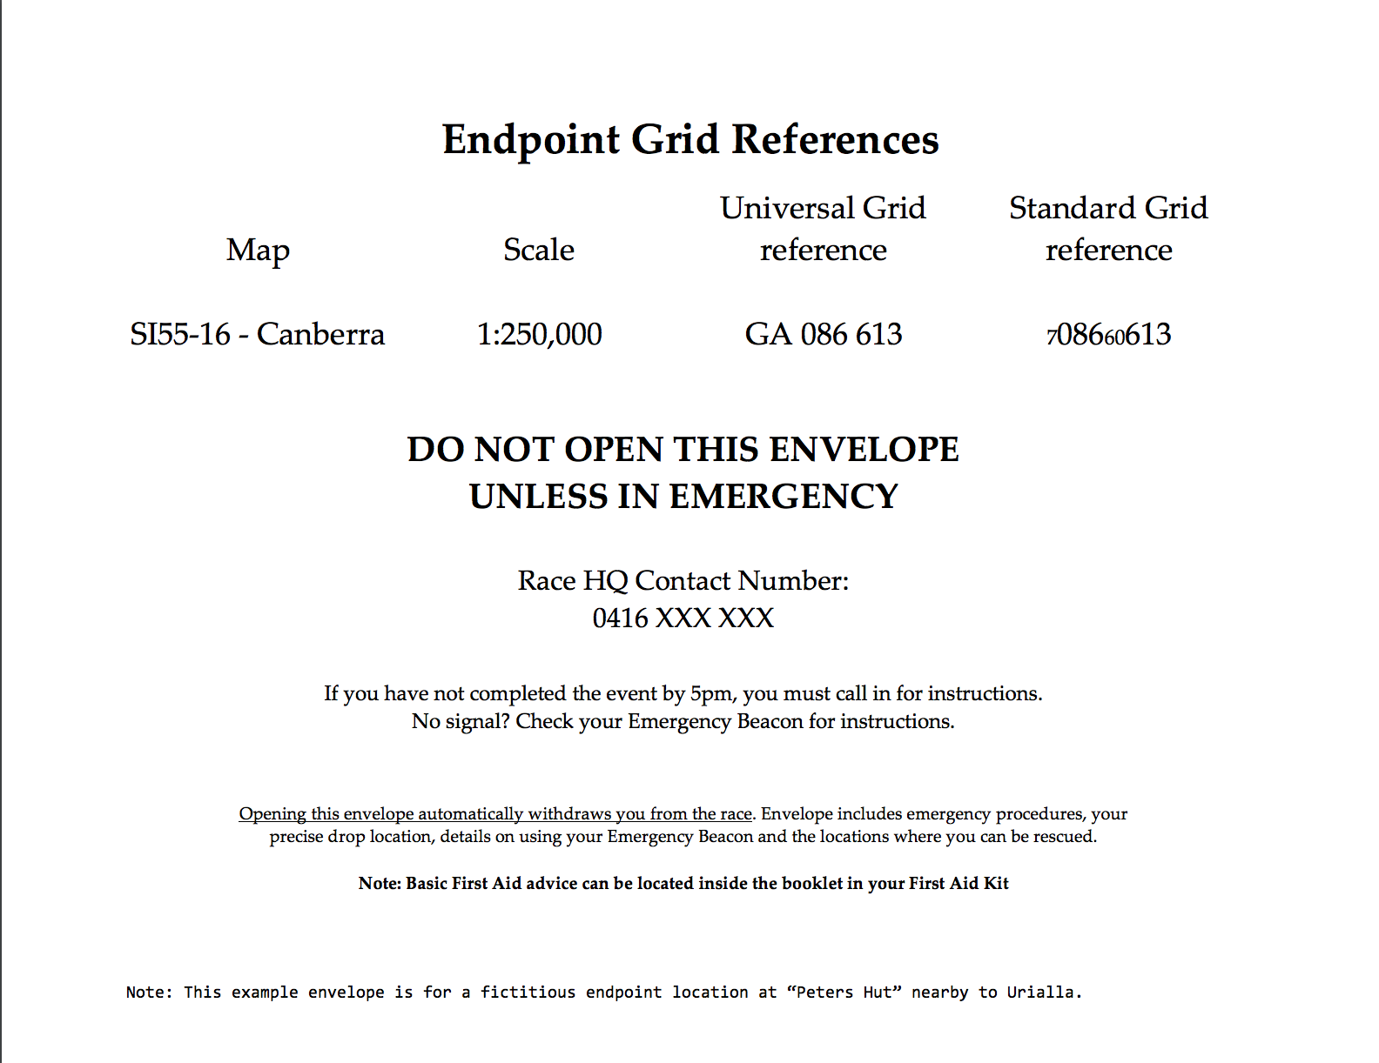
THE EMERGENCY ENVELOPE

Slide 46
THE EMERGENCY ENVELOPE
ONLY open if you require assistance and are WITHDRAWING from the race. Once opened, your team is disqualified from the race.
Envelope contains:
Drop Zones, Locations for Rescue, End Point
Safety Advice, First Aid Instructions
Contact details & tracker instructions

Slide 47
WITHDRAWALS / NON-EMERGENCY INJURIES
Open the envelope. Contact Race HQ:
If no signal, use emergency tracker messaging – instructions in envelope.
Try to contact Race HQ with mobile phone, contact details can be found in envelope
Monitor the emergency tracker continuously for messages from HQ
Notes:
Check if you are nearby a marked “rescue location” and move to it if instructed.

Slide 48
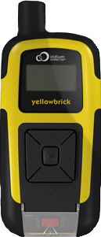
RACE TRACKER

Slide 49
USING YELLOWBRICK
Your YellowBrick can send & receive messages using the Satellite network.
There are two options:
Emergency alerts (life-threatening ONLY)
Send & Receive messages (all other times)
Arrow & OK buttons for navigating the menu
Alert Button under the cover (life-threatening emergencies)
Notes:
Arrow & OK buttons for navigating the menu

Slide 50
EMERGENCY SITUATIONS
IN A LIFE-THREATENING SITUATION
Follow the instructions on your Emergency Action Card
Call the Race HQ for assistance (Sat Phone & Mobile Phone - details in envelope)
Use the emergency ALERT button by opening the cover and holding for 5 seconds
This will dispatch all emergency services (AFP, SES, Rescue Helicopter, Defence Force). Any resulting costs are borne by the person being rescued.
ALERT
Notes:
SES is free, Helicopter will cost $11,000, and you don’t get to choose who you get.

Slide 51
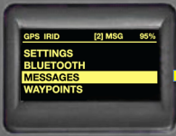
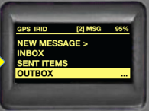
SENDING MESSAGES
MESSAGES
TRACKING
ALERTS
1. Press OK button to open menu
2. Press OK button to open MESSAGES
3. Press OK button on NEW MESSAGE
4. Use down arrow button to select: “Require Help” - non-emergency/withdrawal from Race
5. Press OK button TWICE
6. Select SEND NOW
NEW MESSAGE >
INBOX
SENT ITEMS
YES
NO
REQUIRE HELP
REQUIRE EVACUATION!

Slide 52
MONITOR CONTINUALLY FOR MESSAGES FROM RACE HQ
MESSAGE COUNT
In:1 / Out: 0
yellowbrick
GPS On Tracking
Notes:
THIS INCLUDES DURING THE RACE. IT DOES NOT BEEP.

Slide 53
RECEIVING MESSAGES
1. Press OK button to open menu
2. Press OK button to open MESSAGES
3. Press OK button on INBOX
4. Use down arrow button to select the message.
Race HQ will ask you Yes/No questions - RESPOND!
MESSAGES
TRACKING
ALERTS
NEW MESSAGE
INBOX
SENT ITEMS
Pickup will take 1 hour. Are there any injuries? Reply Yes/No
Notes:
This is a satellite device - will be a lag of several minutes between sending/receiving messages. Be patient.
There is no alert when a message is received. You must check the device every few minutes if you have contacted Race HQ.
It is a satellite device. You need to have a clear view of the sky. Move to higher ground or a more open area if signal is poor.

Slide 54
CUSTOM MESSAGES
Press OK button on FREETEXT
Use the arrow buttons to move around the letters. Push OK button to choose a letter.
When finished, click EXIT & SEND NOW
>INBOX
SENT ITEMS
OUTBOX
FREETEXT
WE ARE STUCK IN A TUNNEL A B C D E F G H I J K L
M N O P Q R S T U V W
X Y Z . _ EXIT
CANCEL
SEND LATER
SEND NOW

Slide 55
Safety when waiting for pick up
This is all in the emergency envelope:
Pick up may take a long time, important to be safe and secure
Find shelter and stay out of the wind
DO NOT start a fire
If you’re on a road, don’t leave it unless absolutely necessary (shelter, water etc)
If a team member is ill or injured, advice about warmth and shelter is particularly important
Keep the team member warm with thermals, clothes and a space blanket
Do not continue along course if it increases risk to health and safety. Stay put and we’ll collect you!

Slide 56
Safety when waiting for pick up
In the unlikely case you absolutely have to split up, go in pairs
If someone is ill or injured, person must stay with them to administer first aid
Only split up if you know where you’re heading and your location, we can help with this over the phone/YellowBrick
Notes:
Splitting up may be necessary if:
You have no signal
Runner is unable to walk to the nearest road to meet the vehicle

Slide 57
Course Setter’s Notes
Inward Bound 2016

Slide 58
TIPS FOR NAVIGATING
Unbroken/solid Road = Reliable Public Road
Broken/dashed Road/Trail … not as reliable, but potentially a good route choice
Once you figure out where you are...plot your entire route from start to finish
Don’t rush!
No one is in danger of running through a purple exclusion zone or off the maps as a result of not picking where they are from the drop point

Slide 59
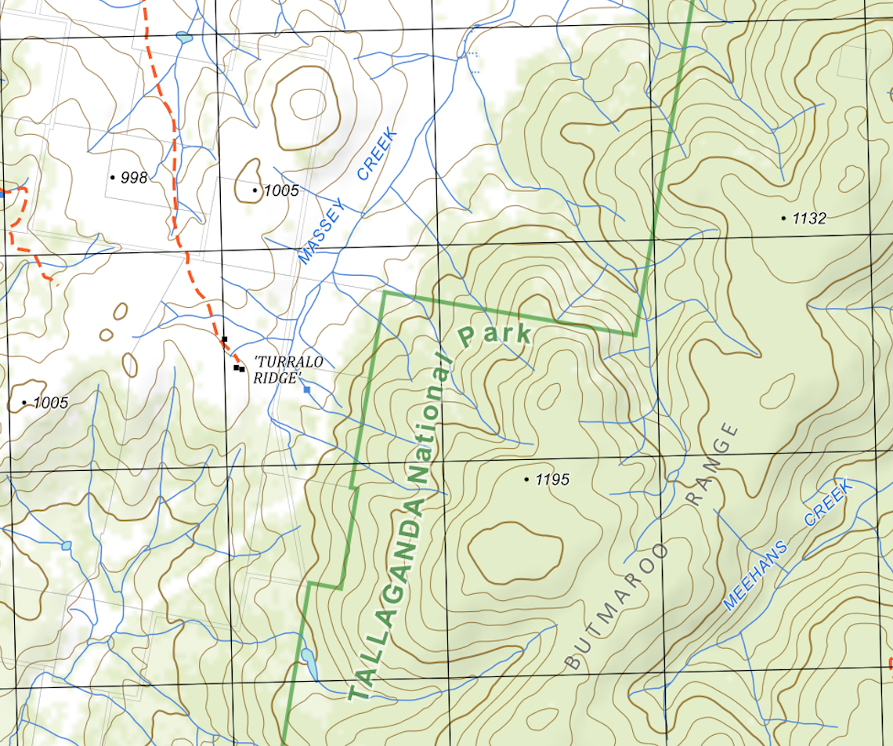
HOW TO READ THE MAP
Dull green area = Forested area (covered in trees)

Slide 60
HOW TO READ THE MAP
White area = Cleared area (No/few trees)

Slide 61
HOW TO READ THE MAP
Brighter green lines = National park/state forest boundary
Realise when you’re in or outside a park

Slide 62
WATER DROPS
New for 2016!
These are at several locations on the course. Their precise locations are given as grid references on your course information sheets. See also the bucket symbol (right) on the maps we give you.
Take no more than 2 L per person
If water is unavailable at a given water drop location, you may use your mobile phone to contact us, and we will get water to you as soon as we practically can.
AN EXCUSE FOR OPENING YOUR SEALED MOBILE PHONE WITHOUT WITHDRAWING FROM THE RACE

Slide 63
KEY RULES
PRIVATE PROPERTY / TRESPASS
Private property is OUT OF BOUNDS
Some exceptions apply – these are shaded in green on your maps and given as grid references on the course information sheet.
You CANNOT “ask for permission”
Notes:
Stress maximum penalty is disqualification of squad in subsequent years

Slide 64
KEY RULES
HIGHWAYS / RAILWAYS
DO NOT RUN ALONG OR CROSS HIGHWAYS (BY ANY MEANS)
Even if there’s a bridge/underpass!
Even if it’s safe!
IF CROSSING A HIGHWAY, YOU MUST DO SO AT THE DESIGNATED CHECKPOINT. THIS IS SHOWN DIRECTLY ON THE MAPS YOU ARE GIVEN AND IT IS ALSO LISTED ON THE COURSE INFORMATION SHEET AS A GRID REFERENCE.
Notes:
STRESS MUST CROSS HIGHWAY AT A CHECKPOINT

Slide 65
KEY RULES
RULE INFRINGEMENTS
Jack Chenoweth is the independent Race Referee.
Your Coaches or College Co-ordinator may lodge complaints with the Referee. There will be a table with a forms on it at EP.
Has to be within 3 hours after the last team (of the whole event) has finished.
Notes:
Referee is Jack
Runners MAY NOT make complaints directly.

Slide 66
Questions?

Slide 67
PRIZE GIVING AND AFTER PARTY
Where: The RUC in Turner at 6:30pm on Monday
Everyone is invited.
Winners from each div get their engraved medal here, not at the finish
College Trophy awarded

Slide 68
DOUGHNUTS

Slide 70
DOUGHNUTS
Remember when drawing doughnuts:
Maps are 1:50000 scale
2cm = 1km

Slide 71
DOUGHNUTS
DIVISION 7: 14-26km

Slide 72
DOUGHNUTS
DIVISION 7: 14-26km
DIVISION 6: 15-29km

Slide 73
DOUGHNUTS
DIVISION 7: 14-26km
DIVISION 6: 15-29km
DIVISION 5: 21-32km

Slide 74
DOUGHNUTS
DIVISION 7: 14-26km
DIVISION 6: 15-29km
DIVISION 5: 21-32km
DIVISION 4: 19-41km

Slide 75
DOUGHNUTS
DIVISION 7: 14-26km
DIVISION 6: 15-29km
DIVISION 5: 21-32km
DIVISION 4: 19-41km
DIVISION 3: 3-46km

Slide 76
DOUGHNUTS
DIVISION 7: 14-26km
DIVISION 6: 15-29km
DIVISION 5: 21-32km
DIVISION 4: 19-41km
DIVISION 3: 3-46km
DIVISION 2: 37-59km

Slide 77
DOUGHNUTS
DIVISION 7: 14-26km
DIVISION 6: 15-29km
DIVISION 5: 21-32km
DIVISION 4: 19-41km
DIVISION 3: 3-46km
DIVISION 2: 37-59km
DIVISION 1: 30-69km

Slide 78
GOOD LUCK SEE YOU ON FRIDAY…
Notes:
SRA at the end

